Slide 1
CHBE446
Chemical Kinetics/Reactors: Theory & Non-Aspen Simulation
Olivia Anderson, Scott Sritharan, Riordan Correll-Brown, Thomas Ogunsola

Slide 2
Chemical Kinetics
Rate of Reaction
Reactions progress from collisions of reactant molecules therefore the rate of reactants will be negative as they are consumed and the rate of products will be positive as they are produced
The order of the reaction(0, 1st, 2nd) determines the relationship between the rate of the reaction and the concentration of the reactant/s.
Raghavan S. (2022). Lecture 1: Basics of Reaction Kinetics
Notes:
scott

Slide 3
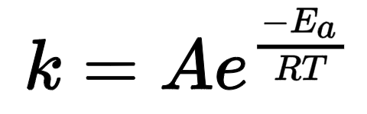
Kinetics: The Arrhenius Equation
A = Pre-exponential factor (independent of temperature)
The amount of times molecules will hit in the orientation necessary to cause a reaction
E_{a} = Activation energy (must match units of R*T)
R = Universal gas constant (8.314 J/mol/K)
T = Temperature in Kelvin
Raghavan S. (2022). Lecture 2: Rate Laws

Slide 4
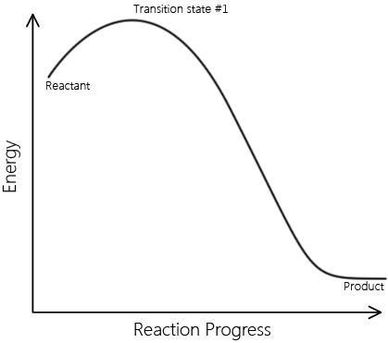
Kinetics: Elementary Reactions
There is only one transition state
There are no intermediate products during the progression of the reaction
Elementary reaction steps can NOT be broken down into simpler steps
LibreTexts
Notes:
https://chem.libretexts.org/Bookshelves/Physical_and_Theoretical_Chemistry_Textbook_Maps/Supplemental_Modules_(Physical_and_Theoretical_Chemistry)/Kinetics/03%3A_Rate_Laws/3.02%3A_Reaction_Mechanisms/3.2.01%3A_Elementary_Reactions

Slide 5
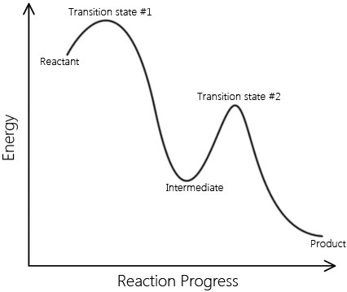
Kinetics: Non-Elementary Reactions
There can be multiple transition states
There is an intermediate product present during the reaction progress
The multiple steps of this reaction can be broken down into simpler elementary steps
LibreTexts
Notes:
https://chem.libretexts.org/Bookshelves/Physical_and_Theoretical_Chemistry_Textbook_Maps/Supplemental_Modules_(Physical_and_Theoretical_Chemistry)/Kinetics/03%3A_Rate_Laws/3.02%3A_Reaction_Mechanisms/3.2.01%3A_Elementary_Reactions

Slide 6
Kinetics: Reversible Reactions & Equilibrium
Reversible reactions can be manipulated by changing the pressure and temperature in accordance with the stoichiometry and thermodynamics of the system
Equilibrium is achieved when the rate of the forward and the backward reactions are equivalent(Keq = 1)
Haber-Bosch:
N₂ + 3H₂ ⇋ 2NH₃ + heat
Keq = [NH₃]²/[H₂]³/[N₂]
According to Le Chatelier's principle, to favor the products, high pressure(100 atm) is needed because there are more moles in the reactants and low temperature(200-300°C) since the reaction is exothermic

Slide 7
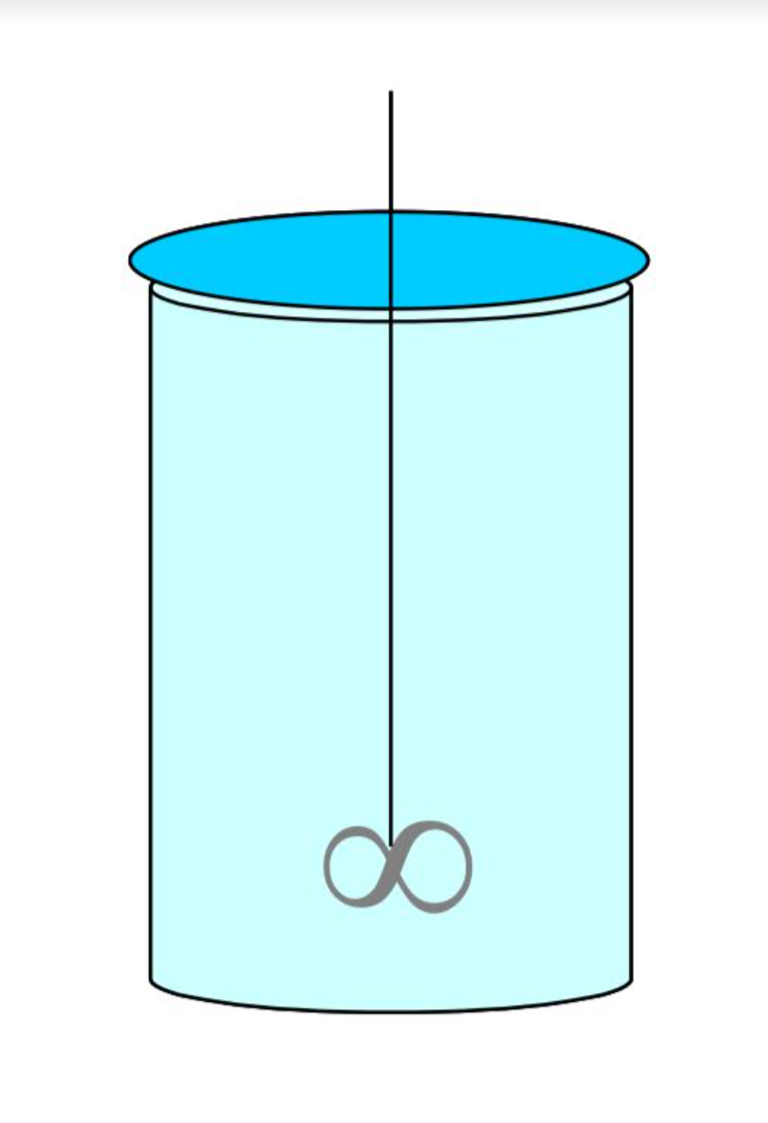
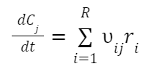
Types : Batch
Mass Balance
Energy Balance
Raghavan S. (2022). Lecture 16: Bioreactors and Washout
Depletion of Reactant
Well-Mixed
Raghavan S. (2022). Lecture 20: Non-Isothermal Reactor Design
Notes:
Rae

Slide 8
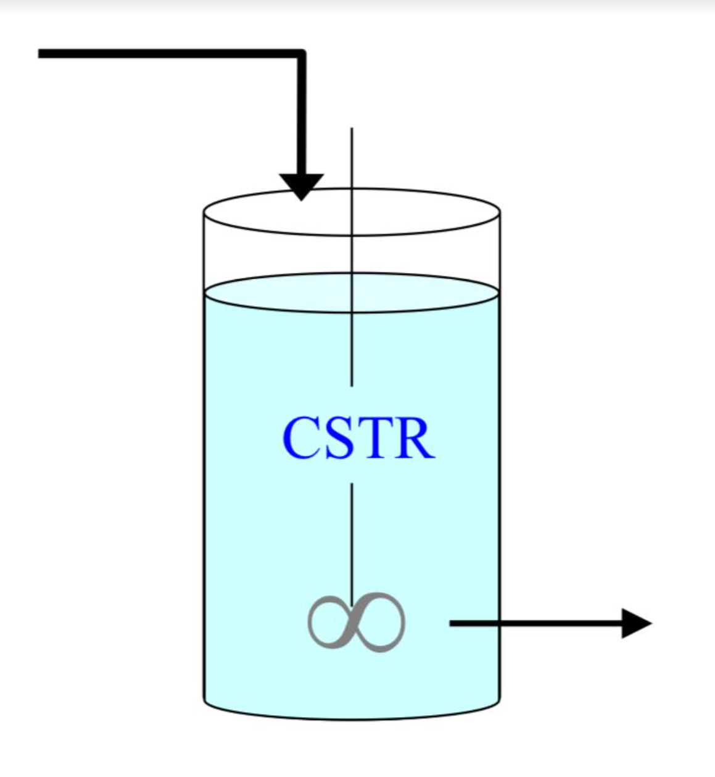
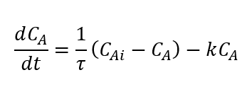
Non-Aspen Simulation: CSTR
Mass Balance
Energy Balance
Raghavan S. (2022). Lecture 20: Non-Isothermal Reactor Design
Well-Mixed
Continuous Addition of Reactant
Operates at Exit Concentration
Raghavan S. (2022). Lecture 21: Energy Balance for Non-Isothermal CSTRs
Notes:
Rae

Slide 9
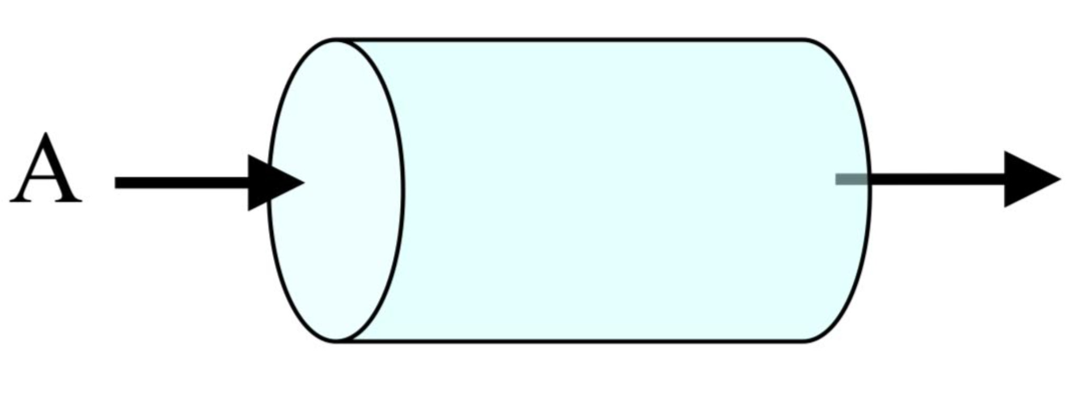
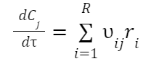
Non-Aspen Simulation: PFR
Mass Balance
Energy Balance
Raghavan S. (2022). Lecture 19: Multiple Reactions in Parallel
Continuous Addition of Reactant
Concentration varies with Length
Higher Product Yield
Raghavan S. (2022). Lecture 23: Design of Nonisothermal PFRs
Notes:
Rae

Slide 10
Non-Aspen Simulation: Example Problem
Reaction
A ⇋ B + heat
Rate Law
r = kC_{A}
Mass Balance
Reactor Type | CSTR
Cooling Mechanism | Cooling Jacket
Dependent Variables | Reactor Temperature and Concentration
Independent Variable | Cooling Jacket Temperature
Energy Balance
Seborg, D. E.; Edgar, T. F.; Mellichamp, D. A.; Doyle, F. J. Process Dynamics and Control; 2017

Slide 11
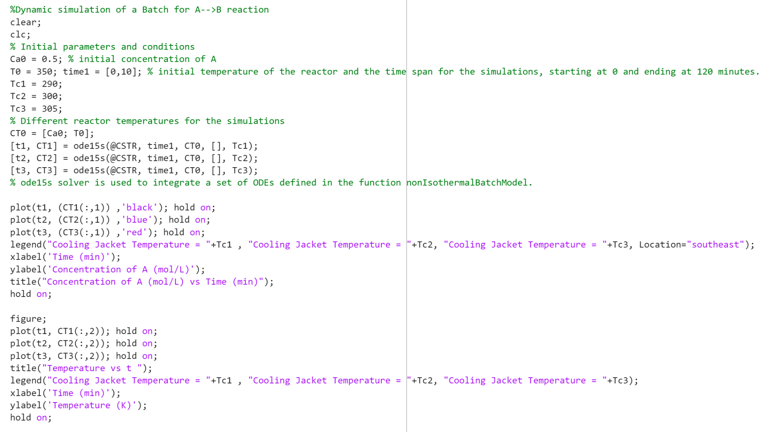

Slide 12
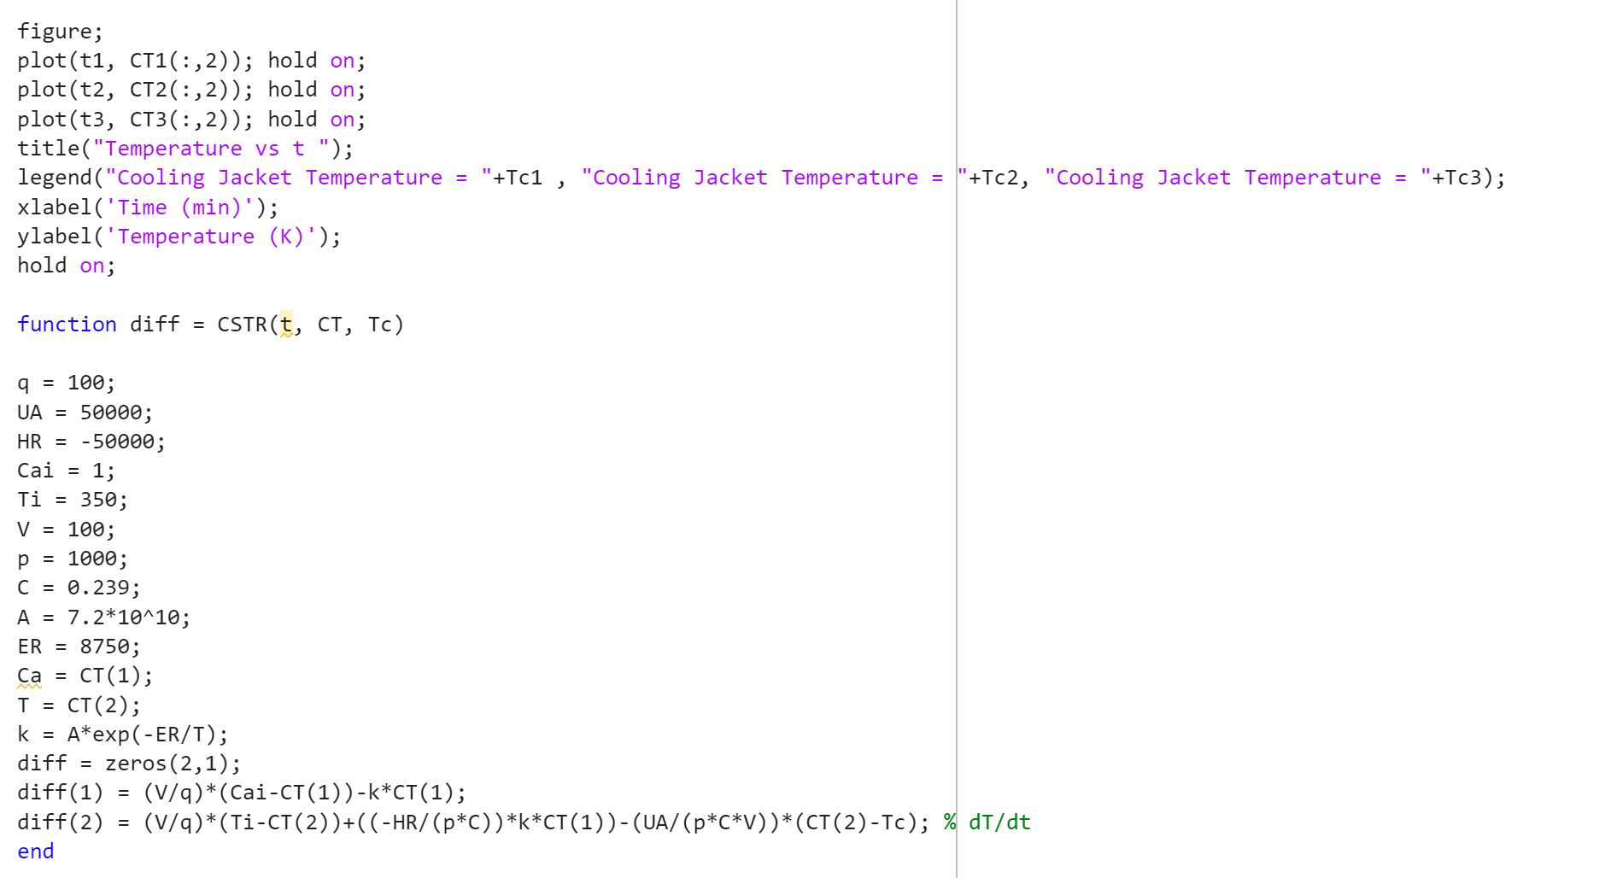

Slide 13
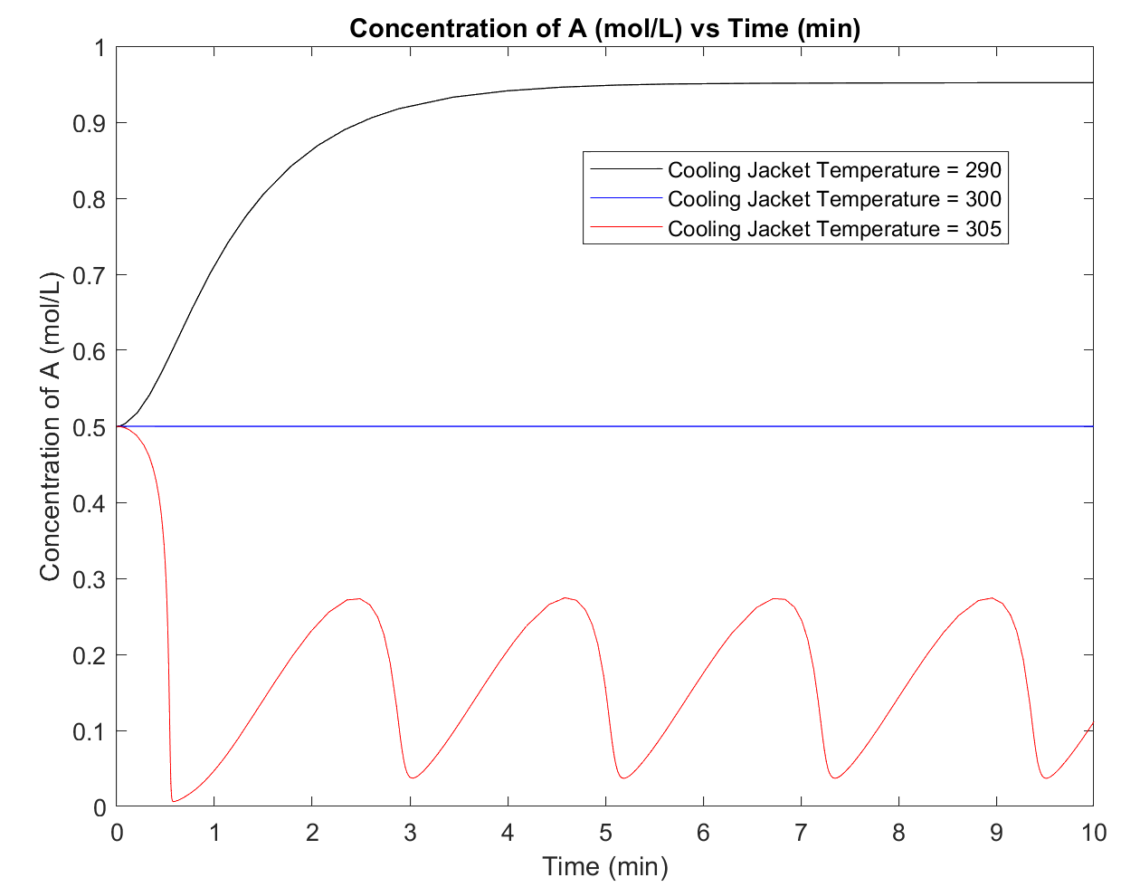
Non-Aspen Simulation: Example Problem Cont.
Matlab ode15s to solve simultaneously
Inadequate temperature control- oscillatory response
↓ Temperature → Accumulation of Reactant

Slide 14
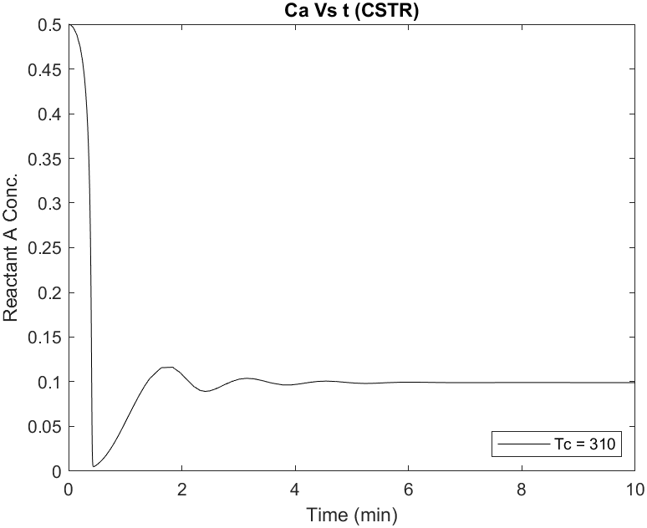
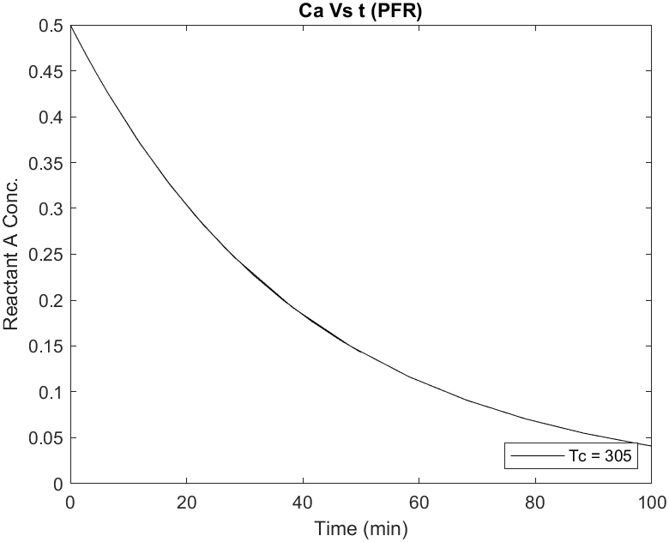
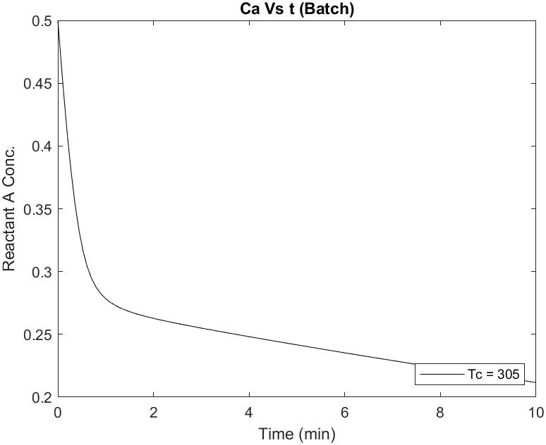
Initial Reactor Parameters:
T₀: 350 C T_{feed} = 350 C
Ca₀ = 0.5 mol/L V = 100 L
T_{jacket}= 305 C ⍴ = 1000 g/L
Q = 100 L/min ΔH = -5*10⁴ J/mol
UA = 5*10⁴ J/min*K k = 7.2*10¹⁰(e^{8750/T})
Non-Aspen Simulation: MATLAB Example
CSTR
PFR
Batch
*Same A ⇋ B + heat reaction with 1st order kinetics*

Slide 15
Steam Reforming
First step in the ammonia synthesis process
Methane, air, and steam are converted into nitrogen and hydrogen, which are then used as reactants in ammonia synthesis (synthesis gas)
Synthesis gas specifications include:
3:1 molar ratio of Hydrogen to Nitrogen
Water-free
CO and CO₂ under 1 ppm each
Concentration of inert gases (Argon, CH₄) is close to zero
Seider, W. D.; Al, E. Product and Process Design Principles : Synthesis, Analysis, and Evaluation; 2019.
Notes:
Steam reform kinetics from NSW website: https://terpconnect.umd.edu/~nsw/chbe446/Ammonia-Seider.pdf
https://www.sciencedirect.com/topics/engineering/water-gas-shift-reaction
https://en.wikipedia.org/wiki/Steam_reforming#cite_note-1
Thomas

Slide 16
Steam Reforming Process Overview
1) Methane is converted to H₂ in the reformer
2) CO and H₂ are generated in the oxidation reactor
3) Water-gas-shift reaction in separate reactor takes place
4) Water is removed in a flash separator
5) CO₂ is removed in a flash separator
1 & 2) CH₄ + H₂O → CO + 3H₂
1 & 3) CO + H₂O → CO₂ + H₂
2) CH₄ + 2O₂ → CO₂ + 2H₂O
Seider, W. D.; Al, E. Product and Process Design Principles : Synthesis, Analysis, and Evaluation; 2019.
Notes:
Steam reform kinetics from NSW website: https://terpconnect.umd.edu/~nsw/chbe446/Ammonia-Seider.pdf
https://www.sciencedirect.com/topics/engineering/water-gas-shift-reaction
https://en.wikipedia.org/wiki/Steam_reforming#cite_note-1
Thomas

Slide 17
Modeling Steam Reforming Kinetics: Reformer
CH₄ + H₂O → CO + 3H₂
CO + H₂O → CO₂ + H₂
Where r_{CH4} and r_{CO} have units of kgmol/(m³・s)
Modeled as an isothermal PFR
Seider, W. D.; Al, E. Product and Process Design Principles : Synthesis, Analysis, and Evaluation; 2019.
Notes:
Steam reform kinetics from NSW website: https://terpconnect.umd.edu/~nsw/chbe446/Ammonia-Seider.pdf
https://www.sciencedirect.com/topics/engineering/water-gas-shift-reaction
https://en.wikipedia.org/wiki/Steam_reforming#cite_note-1
Thomas

Slide 18
Modeling Steam Reforming Kinetics: Oxidation Reactor
Where
CH₄ + 2O₂ → CO₂ + 2H₂O
Where r_{CH4} has units of kgmol/(m³・s)
Methane reaction from the reformer is still occurring as well.
Modeled as an adiabatic PFR
Seider, W. D.; Al, E. Product and Process Design Principles : Synthesis, Analysis, and Evaluation; 2019.
Notes:
Methane reaction from reformer is also still happening
Steam reform kinetics from NSW website: https://terpconnect.umd.edu/~nsw/chbe446/Ammonia-Seider.pdf
https://www.sciencedirect.com/topics/engineering/water-gas-shift-reaction
https://en.wikipedia.org/wiki/Steam_reforming#cite_note-1
Thomas

Slide 19
Modeling Steam Reforming Kinetics: Water-Gas Shift Reactor
CO + H₂O ⇋ CO₂ + H₂
For T < 860 K where r_{CO} has units of kgmol/(m³・s) (second reactor)
Modeled as adiabatic PFRs
Seider, W. D.; Al, E. Product and Process Design Principles : Synthesis, Analysis, and Evaluation; 2019.
Notes:
Steam reform kinetics from NSW website: https://terpconnect.umd.edu/~nsw/chbe446/Ammonia-Seider.pdf
https://www.sciencedirect.com/topics/engineering/water-gas-shift-reaction
https://en.wikipedia.org/wiki/Steam_reforming#cite_note-1
Thomas

Slide 20
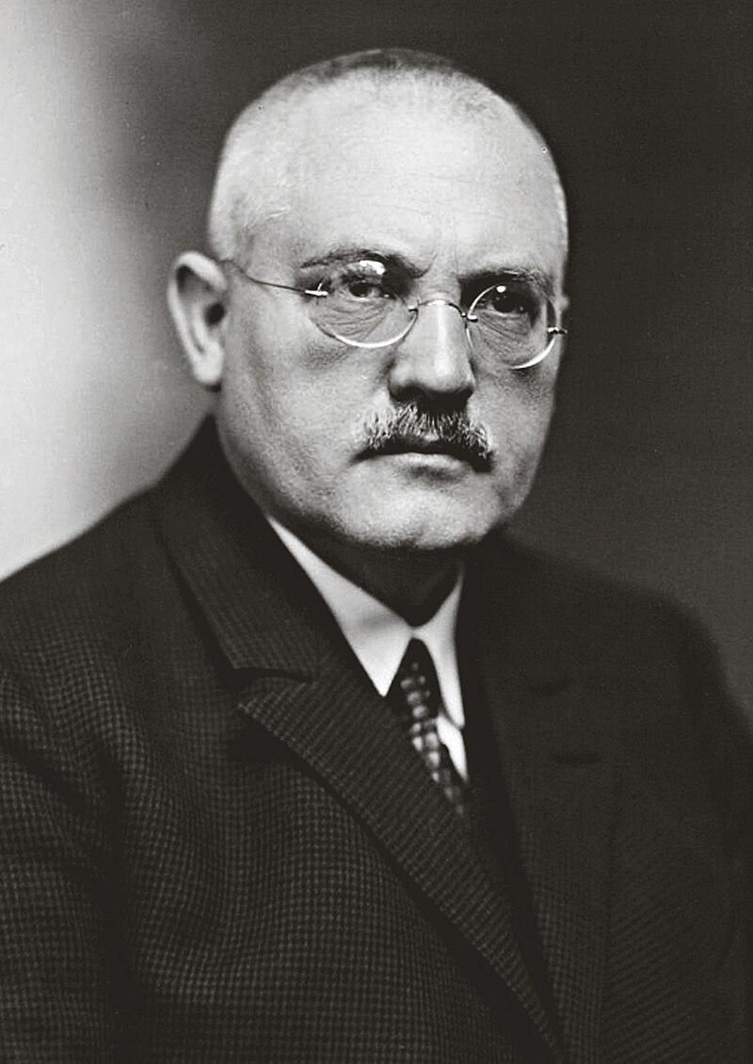
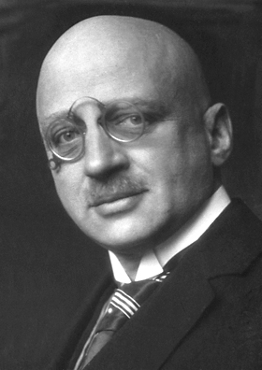
Haber-Bosch Process
N₂ + 3H₂ ⇋ 2NH₃ + heat
Developed in the 1910s by Fritz Haber and Carl Bosch
Synthesizes ammonia from nitrogen and hydrogen gas
Exothermic gas-phase reaction
Revolutionized fertilizer production, increasing crop yields
Wikipedia
Notes:
https://chemguide.co.uk/physical/equilibria/haber.html
Rae
Thomas

Slide 21
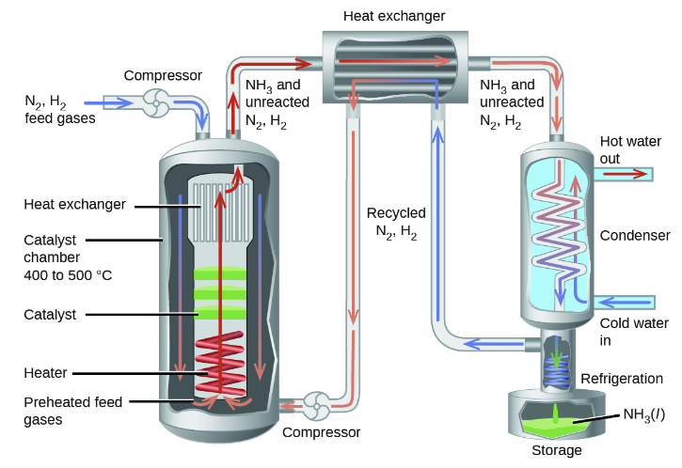
Haber-Bosch: Typical Process Conditions
Uses a catalyst consisting primarily of iron oxide (Fe₃O₄) with KOH, Al₂O₃, and SiO₂.
400-500°C
150-250 bar
Moore, J., Zhou, J., & Garand, E. (n.d.). D37.5 Haber-Bosch process. Chemistry 109 Fall 2021. https://wisc.pb.unizin.org/chem109fall2021ver02/chapter/haber-bosch-process/
Notes:
https://wisc.pb.unizin.org/chem109fall2021ver02/chapter/haber-bosch-process/

Slide 22
Modeling Haber-Bosch Kinetics
Where r_{N2} has units of mol NH₃/(m³ catalyst・s)
Seider, W. D.; Al, E. Product and Process Design Principles : Synthesis, Analysis, and Evaluation; 2019.
Notes:
Seider textbook
Thomas

Slide 23
Non-Aspen Simulation of Haber-Bosch
The Haber-Bosch process can be simulated in MATLAB, Mathcad, and other computational softwares using the reactor design equations and kinetics outlined above.
Multiply the rate equation on slide 21 by m³ catalyst in your reactor to convert it to SI units
Substitute rate law into a reactor design equation, yielding dC_{A}/dt
Include energy balances (dT/dt) or assume isothermal operation
Specify pressures, initial concentrations, and temperatures as needed
Integrate. In MATLAB, the integral of dydx =
[x, y] = ode45(dydx equation, range of integration, initial values)
Wang, N. Ammonia Synthesis via Haber-Bosch Process. CHBE446 Course Website
Notes:
Seider textbook
Thomas

Slide 24
Haber-Bosch Reactor Design: Cold-Shot Reactor
Ammonia formation is exothermic
High temperatures can drive the reaction backwards
To reduce the cost of cooling utilities when ammonia is synthesized in a PFR, cold feed can be injected at various points along the reactor to cool the system
This can be modeled as several PFRs in series
Sriram, G. Mini Project: Ammonia Cold-Shot Reactor Optimization . 2023
Notes:
Citation: Mini-project
Thomas

Slide 25
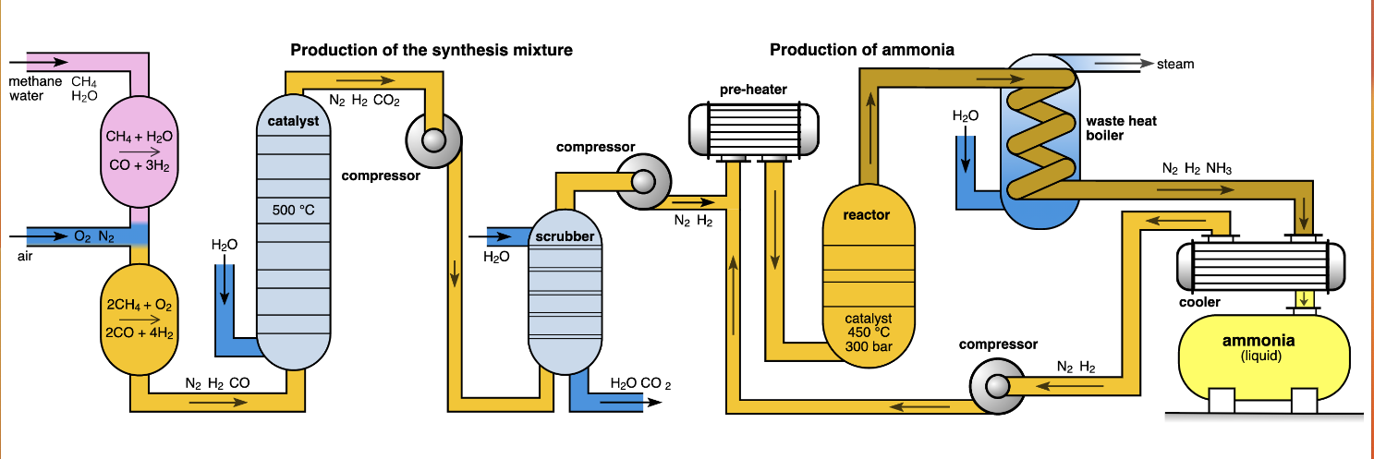
Steam Reforming & Haber-Bosch Process Flow Diagram
Wikimedia Commons https://commons.wikimedia.org/wiki/File:Haber-Bosch-En.svg
Notes:
http://large.stanford.edu/courses/2022/ph240/jimenez2/images/f1big.png

